Slide 1
Clustering
Dr. Kashif Ayyub

Slide 2
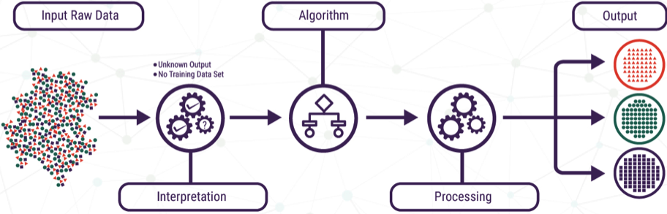
Unsupervised Mining
The users do not need to supervise the model.
Instead, it allows the model to work on its own to discover patterns and information that was previously undetected.
It mainly deals with the unlabeled data.

Slide 3
Applications
Clustering allows you to automatically split the dataset into groups according to similarity. Often, however, cluster analysis overestimates the similarity between groups and doesn’t treat data points as individuals. For this reason, cluster analysis is a poor choice for applications like customer segmentation and targeting.
Anomaly detection can automatically discover unusual data points in your dataset. This is useful in pinpointing fraudulent transactions, discovering faulty pieces of hardware, or identifying an outlier caused by a human error during data entry.
Association rules discovery identifies sets of items that frequently occur together in your dataset. Retailers often use it for basket analysis, because it allows analysts to discover goods often purchased at the same time and develop more effective marketing and merchandising strategies.

Slide 4
Clustering for Understanding
Classes, or conceptually meaningful groups of objects that share common characteristics, play an important role in how people analyze and describe the world.
Indeed, human beings are skilled at dividing objects into groups (clustering) and assigning particular objects to these groups (classification).
For example, even relatively young children can quickly label the objects in a photograph as buildings, vehicles, people, animals, plants, etc.
In the context of understanding data, clusters are potential classes and cluster analysis is the study of techniques for automatically finding classes.

Slide 5
What is Cluster Analysis?
Finding groups of objects such that the objects in a group will be similar (or related) to one another and different from (or unrelated to) the objects in other groups
Inter-cluster distances are maximized
Intra-cluster distances are minimized

Slide 6

Clustering Example – news.google.com

Slide 7
Cluster formation methods
Centroid Based
The clusters are formed by the closeness of data points to the centroid of clusters. Here, the cluster center, i.e. centroid is constructed such that the distance of data points is minimum with the center.
Hierarchical Based
Clusters are constructed as a tree-type structure based on the hierarchy. They have two categories, namely, Agglomerative (Bottom-up approach) and Divisive (Top-down approach).
Density Based
It isolates various density regions based on different densities present in the data space.

Slide 8
K-Means

Slide 9
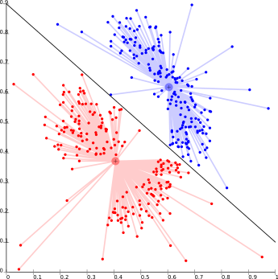
Centroid based clusters
An iterative clustering algorithm in which the clusters are formed by the closeness of data points to the centroid of clusters. Here , the cluster center i.e. centroid is formed such that the distance of data points is minimum with the center.

Slide 10
k-Means Clustering Algorithm
An iterative algorithm that partitions the dataset according to their features into K number of predefined non- overlapping distinct clusters or subgroups.
It makes the data points of inter clusters as similar as possible and also tries to keep the clusters as far as possible.
It allocates the data points to a cluster if the sum of the squared distance between the cluster’s centroid and the data points is at a minimum where the cluster’s centroid is the arithmetic mean of the data points that are in the cluster.

Slide 11
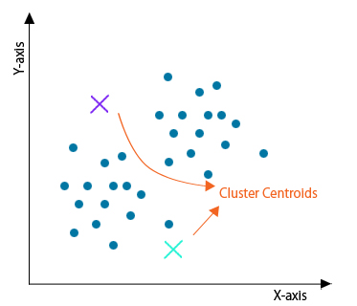
Step 1: Initialization
Initialize any random points called as the centroids of the cluster. While initializing you must take care that the centroids of the cluster must be less than the number of training data points. This algorithm is an iterative algorithm hence the next two steps are performed iteratively.

Slide 12
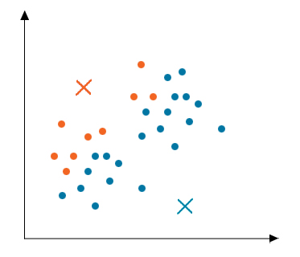
Step 2: Cluster Assignment
After initialization, all data points are traversed and the distance between all the centroids and the data points are calculated. Now the clusters would be formed depending upon the minimum distance from the centroids. In this example, the data is divided into two clusters.

Slide 13
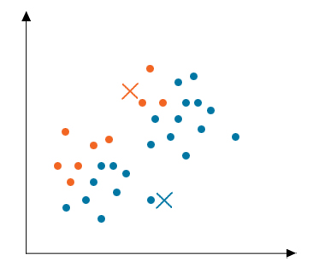
Step 3: Moving Centroid
As the clusters formed in the above step are not optimized so we need to form optimized clusters. For this, we need to move the centroids iteratively to a new location. Take data points of one cluster, compute their average and then move the centroid of that cluster to this new location. Repeat the same step for all other clusters.

Slide 14
Step 4: Optimization
The steps 2 and 3 are done iteratively until the centroids stop moving i.e. they do not change their positions anymore and have become static. Once this is done the k- means algorithm is termed to be converged.

Slide 15
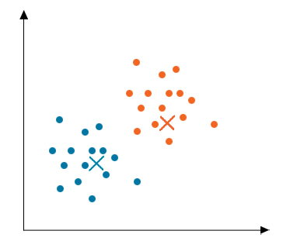
Step 5: Convergence
Now this algorithm has converged and distinct clusters are formed and clearly visible. This algorithm can give different results depending on how the clusters were initialized in the first step.

Slide 16
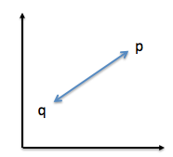
Euclidean Distance
A distance measure between a pair of samples p and q in an n-dimensional feature space:
$$\sqrt{\sum_{i=1}^{n}{{\left(q_{i}−p_{i}\right)}^{2}}}$$
For example, picture it as a “straight, connecting” line in a 2D feature space:

Slide 17
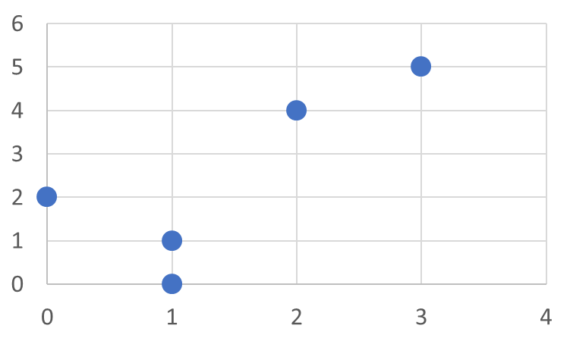
k-Means Demo – Step 1: Initialization
S# | X1 | X2
A | 1 | 1
B | 1 | 0
C | 0 | 2
D | 2 | 4
E | 3 | 5

Slide 18
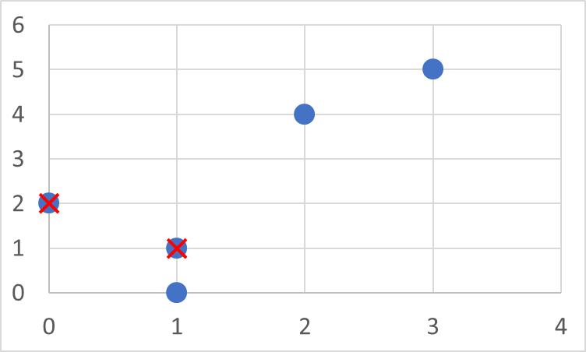
k-Means Demo – Step 2: Cluster Assignment
Consider:
q(1, 1)
p(1,0)
$$\sqrt{\sum_{i=1}^{n}{{\left(q_{i}−p_{i}\right)}^{2}}}$$
$$\sqrt{{\left(q_{x1}−p_{x1}\right)}^{2}+{\left(q_{x2}−p_{x2}\right)}^{2}}$$
$$\sqrt{{\left(1−1\right)}^{2}+{\left(1−0\right)}^{2}}$$
$$\sqrt{1}=1$$
ID | X1 | X2
A | 1 | 1
B | 1 | 0
C | 0 | 2
D | 2 | 4
E | 3 | 5
CID | X1 | X2
$$C_{1}^{0}$$ | 1 | 1
$$C_{2}^{0}$$ | 0 | 2

Slide 19
k-Means Demo – Step 2: Cluster Assignment
ID | X1 | X2 | C1 | C2
A | 1 | 1 | 0 | 1.4
B | 1 | 0 | 1 | 2.2
C | 0 | 2 | 1.4 | 0
D | 2 | 4 | 3.2 | 2.8
E | 3 | 5 | 4.5 | 4.2
CID | X1 | X2
$$C_{1}^{0}$$ | 1 | 1
$$C_{2}^{0}$$ | 0 | 2

Slide 20
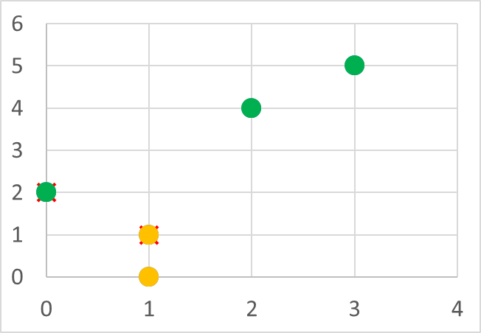
k-Means Demo – Step 2: Cluster Assignment
ID | X1 | X2 | C1 | C2 | CID
A | 1 | 1 | 0 | 1.4 | 1
B | 1 | 0 | 1 | 2.2 | 1
C | 0 | 2 | 1.4 | 0 | 2
D | 2 | 4 | 3.2 | 2.8 | 2
E | 3 | 5 | 4.5 | 4.2 | 2
CID | X1 | X2
$$C_{1}^{0}$$ | 1 | 1
$$C_{2}^{0}$$ | 0 | 2

Slide 21
k-Means Demo – Step 3: Moving Centroid
ID | X1 | X2 | C1 | C2 | CID
A | 1 | 1 | 0 | 1.4 | 1
B | 1 | 0 | 1 | 2.2 | 1
C | 0 | 2 | 1.4 | 0 | 2
D | 2 | 4 | 3.2 | 2.8 | 2
E | 3 | 5 | 4.5 | 4.2 | 2
CID | X1 | X2
$$C_{1}^{1}$$ | $$\frac{1+1}{2}=1$$ | $$\frac{1+0}{2}=0.5$$
$$C_{2}^{1}$$ | $$\frac{0+2+3}{3}=1.67$$ | $$\frac{2+4+5}{3}=3.67$$
CID | X1 | X2
$$C_{1}^{0}$$ | 1 | 1
$$C_{2}^{0}$$ | 0 | 2

Slide 22
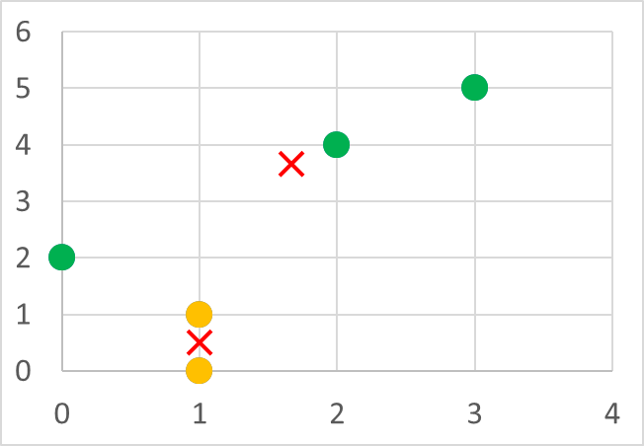
k-Means Demo – Step 3: Moving Centroid
ID | X1 | X2 | C1 | C2 | CID
A | 1 | 1 | 0 | 1.4 | 1
B | 1 | 0 | 1 | 2.2 | 1
C | 0 | 2 | 1.4 | 0 | 2
D | 2 | 4 | 3.2 | 2.8 | 2
E | 3 | 5 | 4.5 | 4.2 | 2
CID | X1 | X2
$$C_{1}^{1}$$ | $$\frac{1+1}{2}=1$$ | $$\frac{1+0}{2}=0.5$$
$$C_{2}^{1}$$ | $$\frac{0+2+3}{3}=1.67$$ | $$\frac{2+4+5}{3}=3.67$$
CID | X1 | X2
$$C_{1}^{0}$$ | 1 | 1
$$C_{2}^{0}$$ | 0 | 2
CID | X1 | X2
$$C_{1}^{1}$$ | 1 | 0.5
$$C_{2}^{1}$$ | 1.67 | 3.67

Slide 23
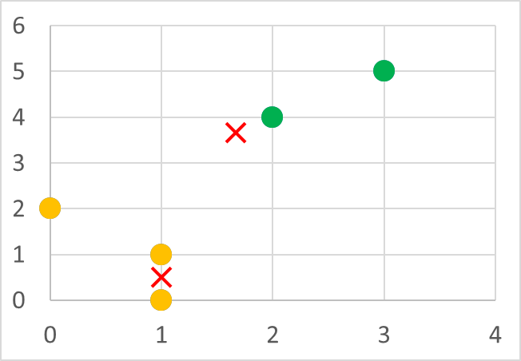
k-Means Demo – Step 4: Optimization
ID | X1 | X2 | C1 | C2 | CID
A | 1 | 1 | 0.5 | 2.7 | 1
B | 1 | 0 | 0.5 | 3.7 | 1
C | 0 | 2 | 1.8 | 2.4 | 1
D | 2 | 4 | 3.6 | 0.5 | 2
E | 3 | 5 | 4.9 | 1.9 | 2
CID | X1 | X2
$$C_{1}^{0}$$ | 1 | 1
$$C_{2}^{0}$$ | 0 | 2
CID | X1 | X2
$$C_{1}^{1}$$ | 1 | 0.5
$$C_{2}^{1}$$ | 1.67 | 3.67

Slide 24
k-Means Demo – Step 4: Optimization
ID | X1 | X2 | C1 | C2 | CID
A | 1 | 1 | 0.5 | 2.7 | 1
B | 1 | 0 | 0.5 | 3.7 | 1
C | 0 | 2 | 1.8 | 2.4 | 1
D | 2 | 4 | 3.6 | 0.5 | 2
E | 3 | 5 | 4.9 | 1.9 | 2
CID | X1 | X2
$$C_{1}^{1}$$ | $$\frac{1+1+0}{3}=0.67$$ | $$\frac{1+0+2}{3}=1$$
$$C_{2}^{1}$$ | $$\frac{2+3}{2}=2.5$$ | $$\frac{4+5}{2}=4.5$$
CID | X1 | X2
$$C_{1}^{0}$$ | 1 | 1
$$C_{2}^{0}$$ | 0 | 2
CID | X1 | X2
$$C_{1}^{1}$$ | 1 | 0.5
$$C_{2}^{1}$$ | 1.67 | 3.67

Slide 25
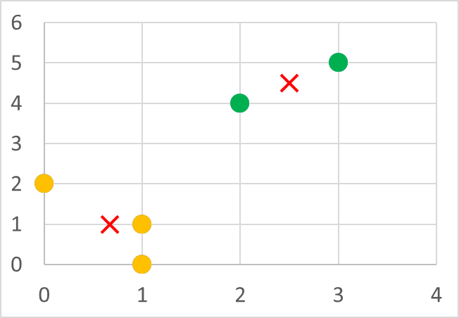
k-Means Demo – Step 4: Optimization
ID | X1 | X2 | C1 | C2 | CID
A | 1 | 1 | 0.5 | 2.7 | 1
B | 1 | 0 | 0.5 | 3.7 | 1
C | 0 | 2 | 1.8 | 2.4 | 1
D | 2 | 4 | 3.6 | 0.5 | 2
E | 3 | 5 | 4.9 | 1.9 | 2
CID | X1 | X2
$$C_{1}^{2}$$ | $$\frac{1+1+0}{3}=0.67$$ | $$\frac{1+0+2}{3}=1$$
$$C_{2}^{2}$$ | $$\frac{2+3}{2}=2.5$$ | $$\frac{4+5}{2}=4.5$$
CID | X1 | X2
$$C_{1}^{1}$$ | 1 | 0.5
$$C_{2}^{1}$$ | 1.67 | 3.67
CID | X1 | X2
$$C_{1}^{2}$$ | 0.67 | 1
$$C_{2}^{2}$$ | 2.5 | 4.5

Slide 26
k-Means Demo – Step 5: Convergence
ID | X1 | X2 | C1 | C2 | CID
A | 1 | 1 | 0.33 | 3.81 | 1
B | 1 | 0 | 1.05 | 4.74 | 1
C | 0 | 2 | 1.20 | 3.54 | 1
D | 2 | 4 | 3.28 | 0.71 | 2
E | 3 | 5 | 4.63 | 0.71 | 2
CID | X1 | X2
$$C_{1}^{1}$$ | 1 | 0.5
$$C_{2}^{1}$$ | 1.67 | 3.67
CID | X1 | X2
$$C_{1}^{2}$$ | 0.67 | 1
$$C_{2}^{2}$$ | 2.5 | 4.5
No change, Done!

Slide 27
Another Example

Slide 28
k-Means Clustering: Discussion
finds a local optimum
often converges quickly
but not always
the choice of initial points can have large influence in the result
tends to find spherical clusters
outliers can cause a problem
different densities may cause a problem

Slide 29
k-Means Clustering: Advantages
K-means is relatively scalable and efficient in processing large data sets
The computational complexity of the algorithm is O(nkt)
n: the total number of objects
k: the number of clusters
t: the number of iterations
Normally: k<<n and t<<n

Slide 30
k-Means Clustering: Disadvantages
Can be applied only when the mean of a cluster is defined
Users need to specify k
K-means is not suitable for clusters of very different size
It is sensitive to noise and outlier data points (can influence the mean value)

Slide 31
k-Medoids Algorithm or PAM(Partitioning Around Medoids)

Slide 32
k-Medoid Algorithm – The Idea
Initial representatives are chosen randomly
The iterative process of replacing representative objects by new representative objects continues as long as the quality of the clustering is improved
For each representative Object O
For each non-representative object R, swap O and R
Choose the configuration with the lowest cost
Cost function is the difference in absolute error-value if a current representative object is replaced by a non-representative object

Slide 33
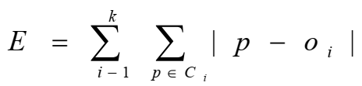
k-Medoid Algorithm
Minimize the sensitivity of k-means to outliers
Pick actual objects to represent clusters instead of mean values
Each remaining object is clustered with the representative object (Medoid) to which is the most similar
The algorithm minimizes the sum of the dissimilarities between each object and its corresponding reference point
E: the sum of absolute error for all objects in the data set P: the data point in the space representing an object
Oi: is the representative object of cluster Ci

Slide 34
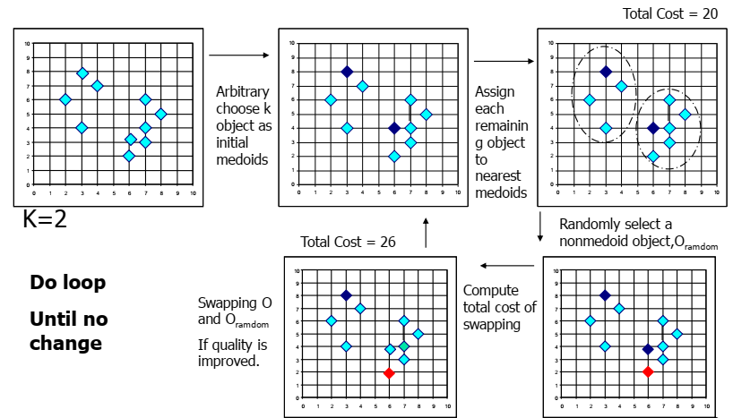
k-Medoids Summarized

Slide 35
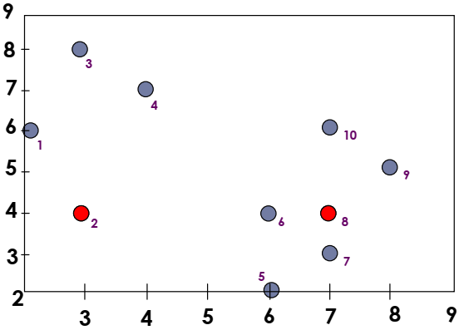
k-Medoid: Example
ID | A1 | A2
O₁ | 2 | 6
O₂ | 3 | 4
O₃ | 3 | 8
O₄ | 4 | 7
O₅ | 6 | 2
O₆ | 6 | 4
O₇ | 7 | 3
O₈ | 7 | 4
O₉ | 8 | 5
O₁₀ | 7 | 6
Goal: create two clusters
Choose randomly two medoids O₂ = (3,4) O₈ = (7,4)

Slide 36
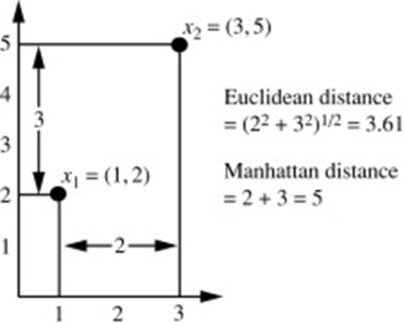
Manhattan Distance
The distance between two points in a grid based on a strictly horizontal and/or vertical path (that is, along the grid lines).

Slide 37
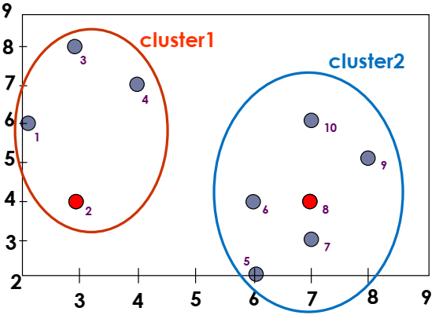
k-Medoid: Example
ID | A1 | A2 | C1D | C2D
O₁ | 2 | 6 | 3 | 7
O₂ | 3 | 4 | 0 | 4
O₃ | 3 | 8 | 4 | 8
O₄ | 4 | 7 | 4 | 6
O₅ | 6 | 2 | 5 | 3
O₆ | 6 | 4 | 3 | 1
O₇ | 7 | 3 | 5 | 1
O₈ | 7 | 4 | 4 | 0
O₉ | 8 | 5 | 6 | 2
O₁₀ | 7 | 6 | 6 | 2
Cluster 1: 1, 2, 3, 4
Cluster 2: 5, 6, 7, 8, 9, 10

Slide 38
k-Medoid: Example
ID | A1 | A2 | C1D | C2D
O₁ | 2 | 6 | 3 | 7
O₂ | 3 | 4 | 0 | 4
O₃ | 3 | 8 | 4 | 8
O₄ | 4 | 7 | 4 | 6
O₅ | 6 | 2 | 5 | 3
O₆ | 6 | 4 | 3 | 1
O₇ | 7 | 3 | 5 | 1
O₈ | 7 | 4 | 4 | 0
O₉ | 8 | 5 | 6 | 2
O₁₀ | 7 | 6 | 6 | 2
Compute the absolute error criterion [for the set of Medoids (O₂, O₈)]
$$E= \sum_{i−1}^{k}{\sum_{p∈C_{i}}{\left|p−o_{i}\right|}}$$
$$E=\left|o_{1}−o_{2}\right|+\left|o_{3}−o_{2}\right|+\left|o_{4}−o_{2}\right|+$$
$\left|o_{5}−o_{8}\right|+$ $\left|o_{6}−o_{8}\right|+$ $\left|o_{7}−o_{8}\right|+$ $\left|o_{9}−o_{8}\right|+$ $\left|o_{10}−o_{8}\right|$
$$E=\left(3+4+4\right)+\left(3+1+1+2+2\right)=20$$

Slide 39
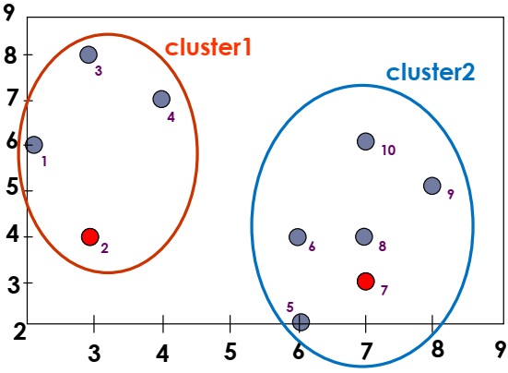
k-Medoid: Example
ID | A1 | A2 | C1D | C2D
O₁ | 2 | 6 | 3 | 8
O₂ | 3 | 4 | 0 | 5
O₃ | 3 | 8 | 4 | 9
O₄ | 4 | 7 | 4 | 7
O₅ | 6 | 2 | 5 | 2
O₆ | 6 | 4 | 3 | 2
O₇ | 7 | 3 | 5 | 0
O₈ | 7 | 4 | 4 | 1
O₉ | 8 | 5 | 6 | 3
O₁₀ | 7 | 6 | 6 | 3
Choose a random object O7
Swap O₈ and O₇
Compute the absolute error criterion [for the set of Medoids (O₂, O₈)]
$$E= \sum_{i−1}^{k}{\sum_{p∈C_{i}}{\left|p−o_{i}\right|}}$$
$$E=\left|o_{1}−o_{2}\right|+\left|o_{3}−o_{2}\right|+\left|o_{4}−o_{2}\right|+$$
$\left|o_{5}−o_{7}\right|+$ $\left|o_{6}−o_{7}\right|+$ $\left|o_{8}−o_{7}\right|+$ $\left|o_{9}−o_{7}\right|+$ $\left|o_{10}−o_{7}\right|$
$$E=\left(3+4+4\right)+\left(2+2+1+3+3\right)=22$$

Slide 40
k-Medoid: Example
ID | A1 | A2 | C1D | C2D
O₁ | 2 | 6 | 3 | 8
O₂ | 3 | 4 | 0 | 5
O₃ | 3 | 8 | 4 | 9
O₄ | 4 | 7 | 4 | 7
O₅ | 6 | 2 | 5 | 2
O₆ | 6 | 4 | 3 | 2
O₇ | 7 | 3 | 5 | 0
O₈ | 7 | 4 | 4 | 1
O₉ | 8 | 5 | 6 | 3
O₁₀ | 7 | 6 | 6 | 3
Compute Cost Function
Cost = Absolute Error [for (O₂, O₇)]
- Absolute Error [for (O₂, O₈)]
Cost = 22 – 20
Cost > 0
⇒ it is a bad idea to replace O₈ by O₇

Slide 41
Hierarchical Clustering

Slide 42
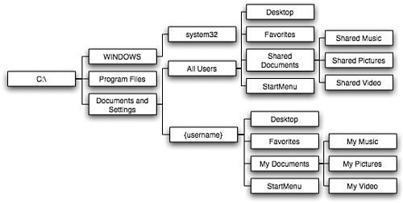
Hierarchical Clustering
Hierarchical clustering (also called hierarchical cluster analysis or HCA) is a method of cluster analysis which seeks to build a hierarchy of clusters. E.g. All files and folders on our hard disk are organized in a hierarchy.

Slide 43
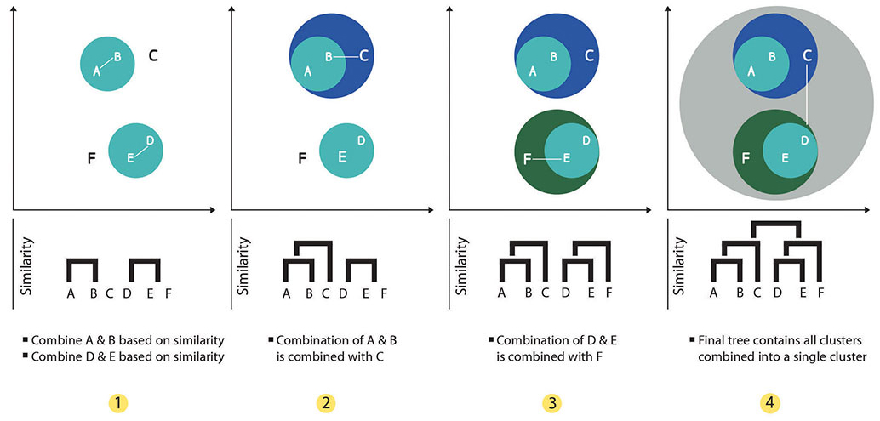
Hierarchical Clustering - Dendrogram
It constructs a binary tree of the data that consecutively combines related ensembles of points. The graphical representation of the resultant hierarchy is a tree-structured graph named dendrogram.

Slide 44
Hierarchical Clustering - Strategies
Agglomerative (bottom-up):
Beginning with singletons (sets with 1 element)
Merging them until S is achieved as the root
In each step, the two closest clusters are aggregates into a new combined cluster
In this way, number of clusters in the dataset is reduced at each step
Eventually, all records/elements are combined into a single huge cluster
It is the most common approach
Divisive (top-down):
All records are combined in to a one big cluster
Then the most dissimilar records being split off recursively partitioning S until singleton sets are reached.

Slide 45
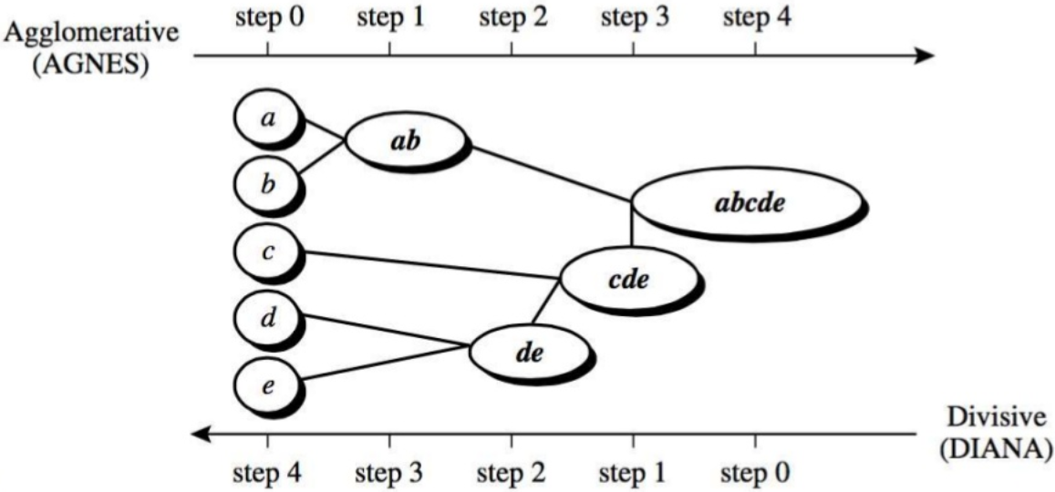
Hierarchical Clustering - Strategies

Slide 46
Hierarchical Agglomerative Clustering - Steps
Start by assigning each item to its own cluster, so that if you have N items, you now have N clusters, each containing just one item. Let the distances (similarities) between the clusters equal the distances (similarities) between the items they contain.
Find the closest (most similar) pair of clusters and merge them into a single cluster, so that now you have one less cluster.
Compute distances (similarities) between the new cluster and each of the old clusters.
Repeat steps 2 and 3 until all items are clustered into a single cluster of size N.

Slide 47
Example - Problem
Suppose I want to divide my students into different groups.
I have the marks scored by each student in an assignment and based on these marks, I want to segment them into groups.
There’s no fixed target here as to how many groups to have.
Since I don’t know what type of students should be assigned to which group, it cannot be solved as a supervised mining problem.
So, I shall try to apply hierarchical clustering here and segment the students into different groups.

Slide 48
Example - Dataset
Let’s take a sample of five students
Reg# | Marks
1 | 10
2 | 7
3 | 28
4 | 20
5 | 35

Slide 49
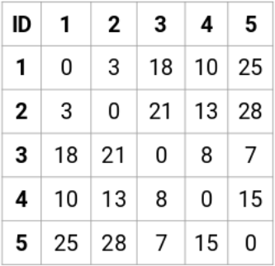
Example – Proximity Matrix
Proximity matrix stores the distances between each point.
Reg# | Marks
1 | 10
2 | 7
3 | 28
4 | 20
5 | 35
Distances have been calculated using Euclidean Distance.
For example: distance between 1 and 2
$$\sqrt{{\left(10−7\right)}^{2}}=\sqrt{9}=3$$

Slide 50

Example – Step 1
Assign all the points to an individual cluster.

Slide 51
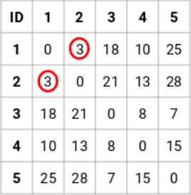
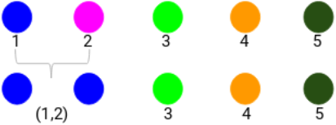
Example – Step 2
Find smallest distance in the proximity matrix and merge the points with the smallest distance:

Slide 52
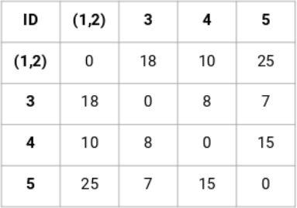
Example – Step 2
Update the tables
Reg# | Marks
1 | 10
2 | 7
3 | 28
4 | 20
5 | 35
Reg# | Marks
(1,2) | 10
3 | 28
4 | 20
5 | 35

Slide 53
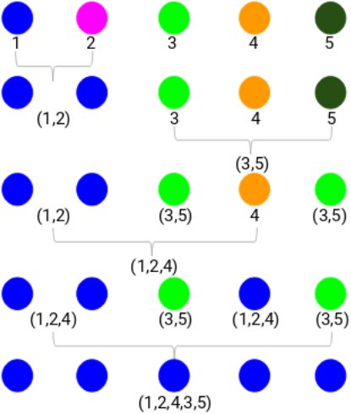
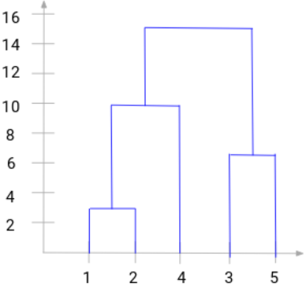
Example – Step 3
Now repeat step 2 until only a single cluster is left.
10
7
28
20
35

Slide 54
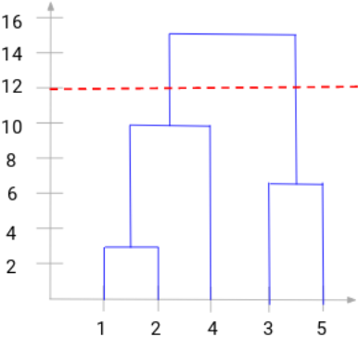
Example – How many clusters?
Now, we can set a threshold distance and draw a horizontal line (Generally, we try to set the threshold in such a way that it cuts the tallest vertical line). Let’s set this threshold as 12 and draw a horizontal line.
The number of clusters will be the number of vertical lines which are being intersected by the line drawn using the threshold. Since the red line intersects 2 vertical lines, we will have 2 clusters. One cluster will have a sample (1,2,4) and the other will have a sample (3,5).

Slide 55
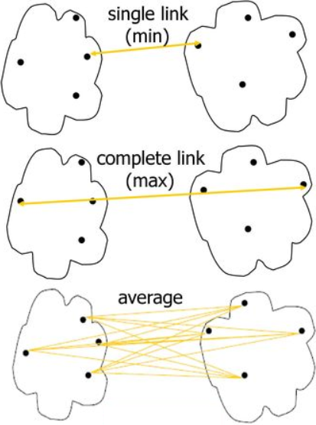
Distance Measures
Single link: smallest distance between an element in one cluster and an element in the other, i.e.,
$d\left(C_{i},C_{j}\right)=min⁡\{d(X_{ip}$, $X_{jq}$)}
Complete link: largest distance between an element in one cluster and an element in the other, i.e.,
$d\left(C_{i},C_{j}\right)=max⁡\{d(X_{ip}$, $X_{jq}$)}
Average: avg distance between elements in one cluster and elements in the other, i.e.,
$d\left(C_{i},C_{j}\right)=avg\{d(X_{ip}$, $X_{jq}$)}

Slide 56
Summary
Hierarchical Clustering
For a dataset consisting of n points
O(n²) space; it requires storing the distance matrix
O(n³) time complexity in most of the cases(agglomerative clustering)
Advantages
Dendrograms are great for visualization
Provides hierarchical relations between clusters
Disadvantages
Not easy to define levels for clusters
Can never undo what was done previously
Sensitive to cluster distance measures and noise/outliers
Experiments showed that other clustering techniques
outperform hierarchical clustering
There are several variants to overcome its weaknesses
BIRCH: scalable to a large data set
ROCK: clustering categorical data
CHAMELEON: hierarchical clustering using dynamic modelling

Slide 57
Divisive Hierarchical Clustering
Divisive or DIANA(DIvisive ANAlysis Clustering) is a top-down clustering approach.
The process starts at the root with all the points as one cluster.
It recursively splits the higher level clusters to build the dendrogram.
Can be considered as a global approach.
Divisive clustering is good at identifying large clusters while agglomerative clustering is good at identifying small clusters.

Slide 58
Hierarchical Clustering - Strategies

Slide 59
Hierarchical Clustering - Steps
Start with all data points in the cluster.
After each iteration, remove the outsiders/heterogeneous objects from the cluster.
Stop when each example is in its own singleton cluster, else go to step 2.

Slide 60
Example - Divisive Hierarchical Clustering
ID | X₁ | X₂ | X₃
1 | 1 | 6 | -1
2 | 3 | 7 | 0
3 | 3 | 5 | -2
4 | 4 | 8 | -1
5 | 5 | 8 | 0
ID | 1 | 2 | 3 | 4 | 5
1 | 0 | 4 | 4 | 5 | 7
2 | 4 | 0 | 4 | 3 | 3
3 | 4 | 4 | 0 | 5 | 7
4 | 5 | 3 | 5 | 0 | 2
5 | 7 | 3 | 7 | 2 | 0
Proximity Matrix using Manhattan Distance
Top level cluster A{1,2,3,4,5} is all the 5 points

Slide 61
Example
Find most dissimilar point
Take the average distance to the other points. So, just for example, for point 1 we compute
$$\frac{\left[d\left(1,2\right)+d\left(1,3\right)+d\left(1,4\right)+d(1,5)\right]}{4}$$
$$=\frac{\left[4+4+5+7\right]}{4}=5$$
Similarly, average distances for all the points are:
ID | 1 | 2 | 3 | 4 | 5
1 | 0 | 4 | 4 | 5 | 7
2 | 4 | 0 | 4 | 3 | 3
3 | 4 | 4 | 0 | 5 | 7
4 | 5 | 3 | 5 | 0 | 2
5 | 7 | 3 | 7 | 2 | 0
Proximity Matrix using Manhattan Distance
Point | 1 | 2 | 3 | 4 | 5
Distance | 5.00 | 3.50 | 5.00 | 3.75 | 4.75

Slide 62
Example
Since points 1 and 3 are tied for the most dissimilar, we pick one of these arbitrarily.
I will use point 1.
Now we have
A = {2,3,4,5}
B = {1}
Point | 1 | 2 | 3 | 4 | 5
Distance | 5.00 | 3.50 | 5.00 | 3.75 | 4.75

Slide 63
Example
Now we want to move any points that are closer to B than (the other points in) A into B. So for each point x in A we compute d(x, A) and d(x,B). For example, for point 2 we compute:
$$\frac{\left[d\left(2,3\right)+d\left(2,4\right)+d\left(2,5\right)\right]}{3}−[d\left(2,1\right)]$$
$$=\frac{\left[4+3+3\right]}{3}−4=−0.67$$
Similarly, average distances for all the points are:
ID | 1 | 2 | 3 | 4 | 5
1 | 0 | 4 | 4 | 5 | 7
2 | 4 | 0 | 4 | 3 | 3
3 | 4 | 4 | 0 | 5 | 7
4 | 5 | 3 | 5 | 0 | 2
5 | 7 | 3 | 7 | 2 | 0
Point | 2 | 3 | 4 | 5
Distance | -0.67 | 1.33 | -1.67 | -3
Proximity Matrix using Manhattan Distance

Slide 64
Example
Only point 3 is bigger than zero so we move it to cluster B.
Now we have
A = {2,4,5}
B = {1,3}
Point | 2 | 3 | 4 | 5
Distance | -0.67 | 1.33 | -1.67 | -3

Slide 65
Example
We check if any additional points should be moved. Again, we compute d(x, A) - d(x,B) for each point in A. The differences are:
ID | 1 | 2 | 3 | 4 | 5
1 | 0 | 4 | 4 | 5 | 7
2 | 4 | 0 | 4 | 3 | 3
3 | 4 | 4 | 0 | 5 | 7
4 | 5 | 3 | 5 | 0 | 2
5 | 7 | 3 | 7 | 2 | 0
Point | 2 | 4 | 5
Distance | -1.0 | -2.5 | -4.5
All are negative (that is the remaining points in A are closer to A than to B), so we stop this division and we have the two clusters {2,4,5} and {1,3}.
Proximity Matrix using Manhattan Distance

Slide 66
Example
For the next step, we choose the cluster with the largest diameter, that is the cluster with the greatest distance between two points in the cluster.
$$diameter\left(\left\{1,3\right\}\right) =d\left(1,3\right)=4$$
$$diameter\left(\left\{2,4,5\right\}\right)=\max\left[d\left(2,4\right),d\left(2,5\right),d\left(4,5\right)\right]=\max\left(3,3,2\right)=3$$
So cluster {1,3} has the largest diameter. Trivially, this will be split into {1} and {3}. So now we have clusters {2,4,5}, {1} and {3}.
Now recursively apply the same steps to {2,4,5} to split it further.
ID | 1 | 2 | 3 | 4 | 5
1 | 0 | 4 | 4 | 5 | 7
2 | 4 | 0 | 4 | 3 | 3
3 | 4 | 4 | 0 | 5 | 7
4 | 5 | 3 | 5 | 0 | 2
5 | 7 | 3 | 7 | 2 | 0
Proximity Matrix using Manhattan Distance

Slide 67
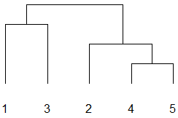
Example - Dendrogram
ID | 1 | 2 | 3 | 4 | 5
1 | 0 | 4 | 4 | 5 | 7
2 | 4 | 0 | 4 | 3 | 3
3 | 4 | 4 | 0 | 5 | 7
4 | 5 | 3 | 5 | 0 | 2
5 | 7 | 3 | 7 | 2 | 0
Proximity Matrix using Manhattan Distance

Slide 68
Density-Based Spatial Clustering of Applications with Noise (DBSCAN)

Slide 69
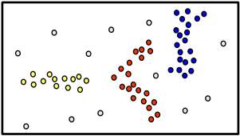
DBSCAN
Density-based spatial clustering of applications with noise (DBSCAN).
Clusters are dense regions in the data space, separated by regions of lower object density
A cluster is defined as a maximal set of density connected points
Discovers clusters of arbitrary shape

Slide 70
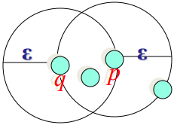
Density Definition
ε-Neighborhood: Objects within a radius of ε from an object.
High density: ε -Neighborhood of an object contains at least MinPts of objects.
For example:
Density of p is “high” (MinPts = 4)
Density of q is “low” (MinPts = 4)

Slide 71
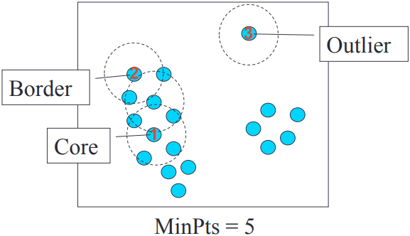
Core, Border, & Outlier
Three category for each point
Core Point: if its density is high (i.e. Nbhd(p,ε)>=MinPts)
Border Point: density is low (but in the neighborhood of a core point) [i.e. directly reachable from some core point (e.g. p)]
Noise Point: any point that is neither a core point nor a border point
For further reading: https://blog.dominodatalab.com/topology-and-density-based-clustering/
Notes:
Core Points: A data point p is a core point if Nbhd(p,ɛ) [ɛ-neighborhood of p] contains at least minPts ; |Nbhd(p,ɛ)| >= minPts.
Border Points: A data point *q is a border point if Nbhd(q, ɛ) contains less than minPts data points, but q is reachable from some core point p.
Outlier: A data point o is an outlier if it is neither a core point nor a border point. Essentially, this is the “other” class.

Slide 72
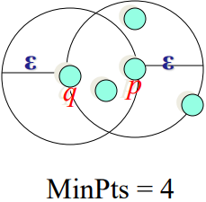
Density Reachability
Directly Density-Reachable
A point q is directly density-reachable from a point p: if p is a core point and q is in p’s ε-neighborhood
q is directly density-reachable from p, because p is core and q is border
p is not directly density-reachable from q
Density-reachability is asymmetric

Slide 73
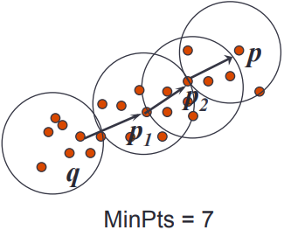
Density Reachability
Density-Reachable
A point p is density-reachable from a point q
If there is a chain of points p₁, … , p_{n}, with p₁ = q, p_{n} = p such that p_{i+1} is directly density-reachable from p_{i}
p₁ is directly density-reachable from q
p₂ is directly density-reachable from p1
p is directly density-reachable from p₂
There is a chain from q to p (q→p₁→p₂→p)

Slide 74
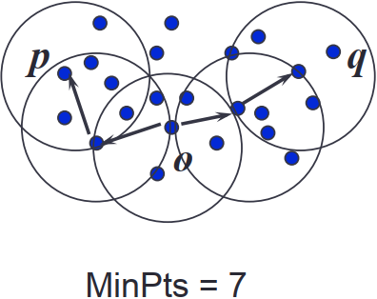
Density Connectivity
A pair of points p and q are density-connected
If they are commonly density-reachable from a point o

Slide 75
DBSCAN Algorithm
for each o ∈ D do
if o is not yet classified then
if o is a core-object then
collect all objects density-reachable from
o and assign them to a new cluster.
else
assign o to NOISE

Slide 76
Example – Compute Proximity Matrix
Dataset
Proximity/Distance Matrix
ID | X1 | X2
A1 | 2 | 10
A2 | 2 | 5
A3 | 8 | 4
A4 | 5 | 8
A5 | 7 | 5
A6 | 6 | 4
A7 | 1 | 2
A8 | 4 | 9
ID | A1 | A2 | A3 | A4 | A5 | A6 | A7 | A8
A1 | 0 | 5.00 | 6.00 | 3.61 | 7.07 | 7.21 | 8.06 | 2.24
A2 | 5.00 | 0 | 6.08 | 4.24 | 5.00 | 4.12 | 3.16 | 4.47
A3 | 6.00 | 6.08 | 0 | 5.00 | 1.41 | 1.41 | 7.28 | 6.40
A4 | 3.61 | 4.24 | 5.00 | 0 | 3.61 | 4.12 | 7.21 | 1.41
A5 | 7.07 | 5.00 | 1.41 | 3.61 | 0 | 1.41 | 6.71 | 5.00
A6 | 7.21 | 4.12 | 1.41 | 4.12 | 1.41 | 0 | 5.39 | 5.39
A7 | 8.06 | 3.16 | 7.28 | 7.21 | 6.71 | 5.39 | 0 | 7.62
A8 | 2.24 | 4.47 | 6.40 | 1.41 | 5.00 | 5.39 | 7.62 | 0
Use the Euclidean distance formula to calculate the proximity matrix

Slide 77
Example – Compute ε Neighborhood
ε Neighborhood
Proximity/Distance Matrix
ID | ε Neighborhood
A1 | {}
A2 | {}
A3 | {A5, A6}
A4 | {A8}
A5 | {A3, A6}
A6 | {A3, A5}
A7 | {}
A8 | {A4}
ID | A1 | A2 | A3 | A4 | A5 | A6 | A7 | A8
A1 | 0 | 5.00 | 6.00 | 3.61 | 7.07 | 7.21 | 8.06 | 2.24
A2 | 5.00 | 0 | 6.08 | 4.24 | 5.00 | 4.12 | 3.16 | 4.47
A3 | 6.00 | 6.08 | 0 | 5.00 | 1.41 | 1.41 | 7.28 | 6.40
A4 | 3.61 | 4.24 | 5.00 | 0 | 3.61 | 4.12 | 7.21 | 1.41
A5 | 7.07 | 5.00 | 1.41 | 3.61 | 0 | 1.41 | 6.71 | 5.00
A6 | 7.21 | 4.12 | 1.41 | 4.12 | 1.41 | 0 | 5.39 | 5.39
A7 | 8.06 | 3.16 | 7.28 | 7.21 | 6.71 | 5.39 | 0 | 7.62
A8 | 2.24 | 4.47 | 6.40 | 1.41 | 5.00 | 5.39 | 7.62 | 0
ε=2, MinPts=2

Slide 78
Example – Clusters
ε Neighborhood
ID | X1
A1 | {}
A2 | {}
A3 | {A5, A6}
A4 | {A8}
A5 | {A3, A6}
A6 | {A3, A5}
A7 | {}
A8 | {A4}
Cluster 1: {A3, A5, A6}
Cluster 2: {A4, A8}
Outliers: A1, A2, A7
ε=2, MinPts=2

Slide 79

Evaluating Clusters
Evaluating clusters is a critical step in clustering analysis to determine the quality and validity of the generated clusters.
Silhouette Coefficient
The Silhouette Coefficient is defined for each sample and is composed of two scores:
a: The mean distance between a sample and all other points in the same cluster.
b: The mean distance between a sample and all other points in the next nearest cluster.
The score is between -1 for incorrect clustering and +1 for highly dense clustering. Scores around zero indicate overlapping clusters.

Slide 80
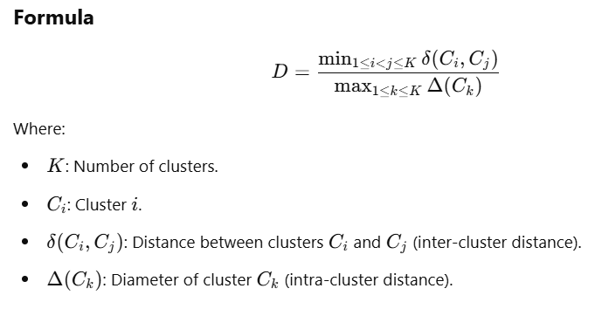
Evaluating Clusters
Dunn Index
The Dunn Index evaluates the quality of clustering by considering the ratio of the minimum inter-cluster distance to the maximum intra-cluster distance. Higher Dunn Index values indicate better clustering.

